Slide 1
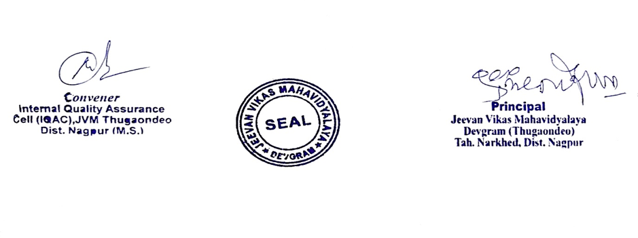
JEEVAN VIKAS MAHAVIDYALAYA, DEVGRAM
Tah. Narkhed, Dist. Nagpur-441301 (M.S.) (Permanent Affiliated to Rashtrasant Tukadoji Maharaj Nagpur University, Nagpur)
College Code: 341
(NAAC Accredited in Cycle II with ‘B++’ Grade, CGPA 2.93)
ISO 9001:2015 Certified, NIRF Participated
Website: www.jvmd.co.in E-mail: jvmthugaondeo@gmail.com
JVMD/2022/14 Date: 01/01/2022
Declaration
This is to declare that the information, reports, true copies and numerical data etc. furnished in this file as supporting documents is verified by IQAC and found correct.
Hence this certificate.

Slide 2
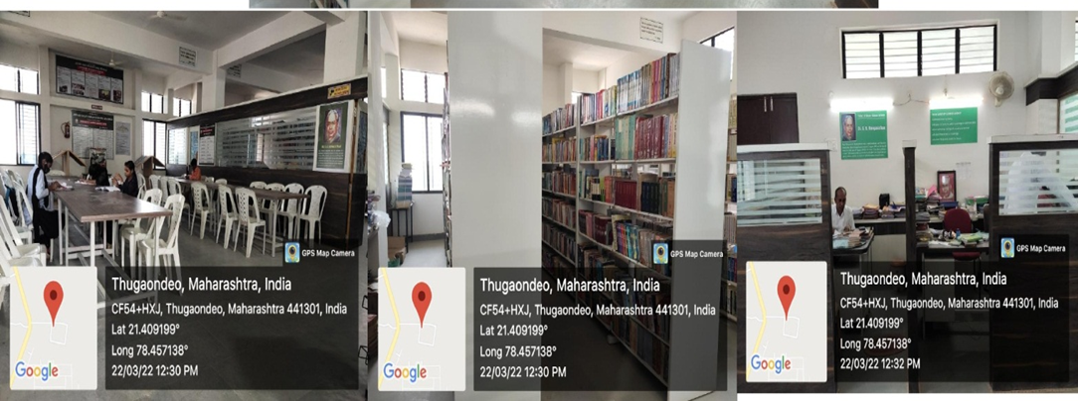
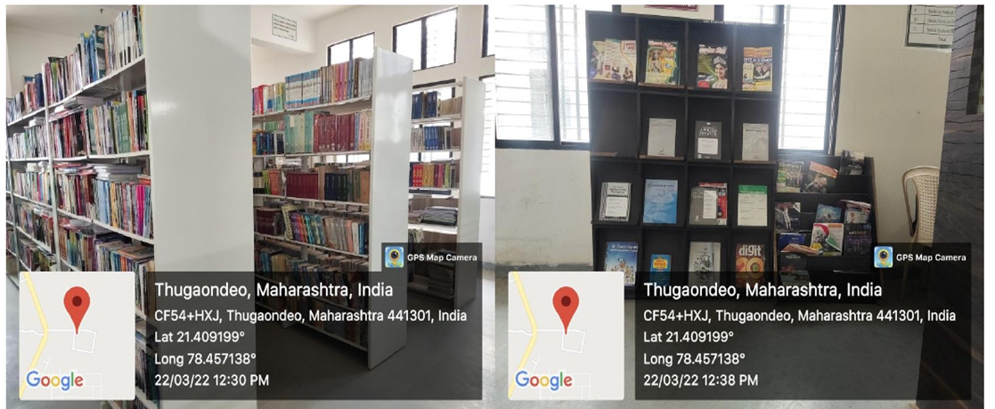

Slide 3
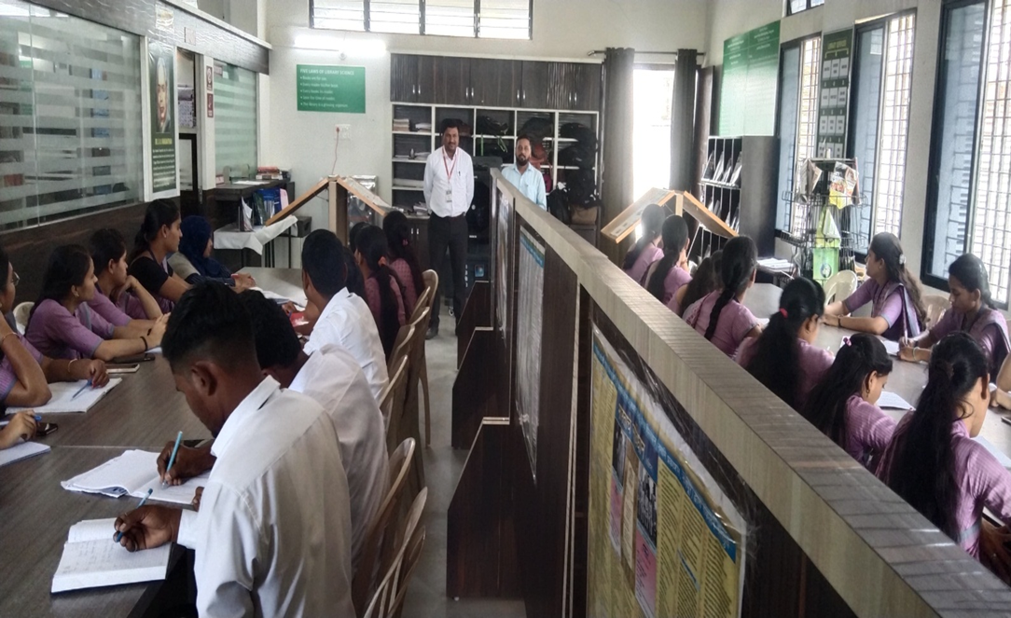
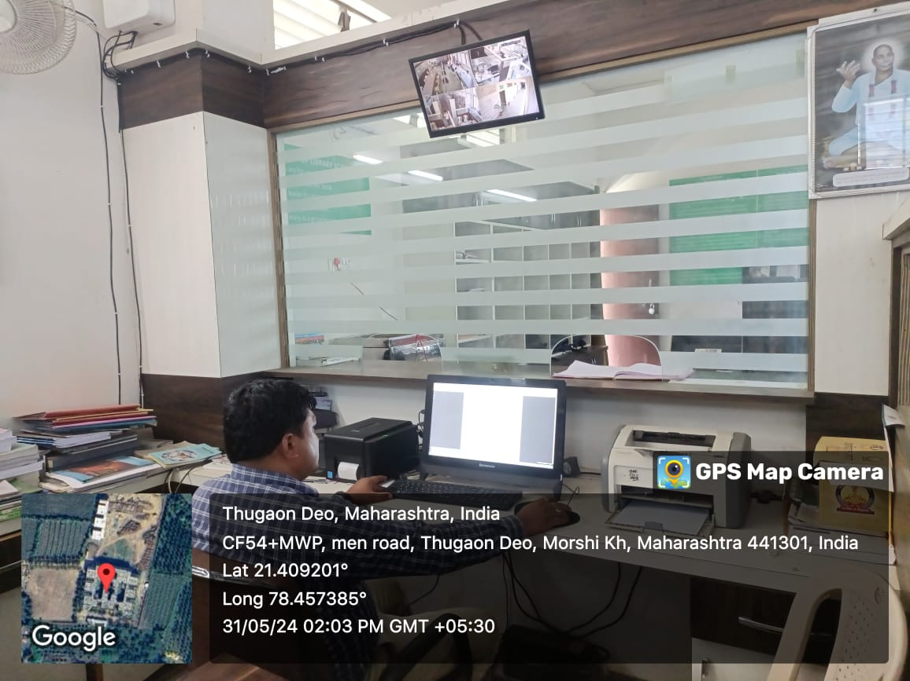
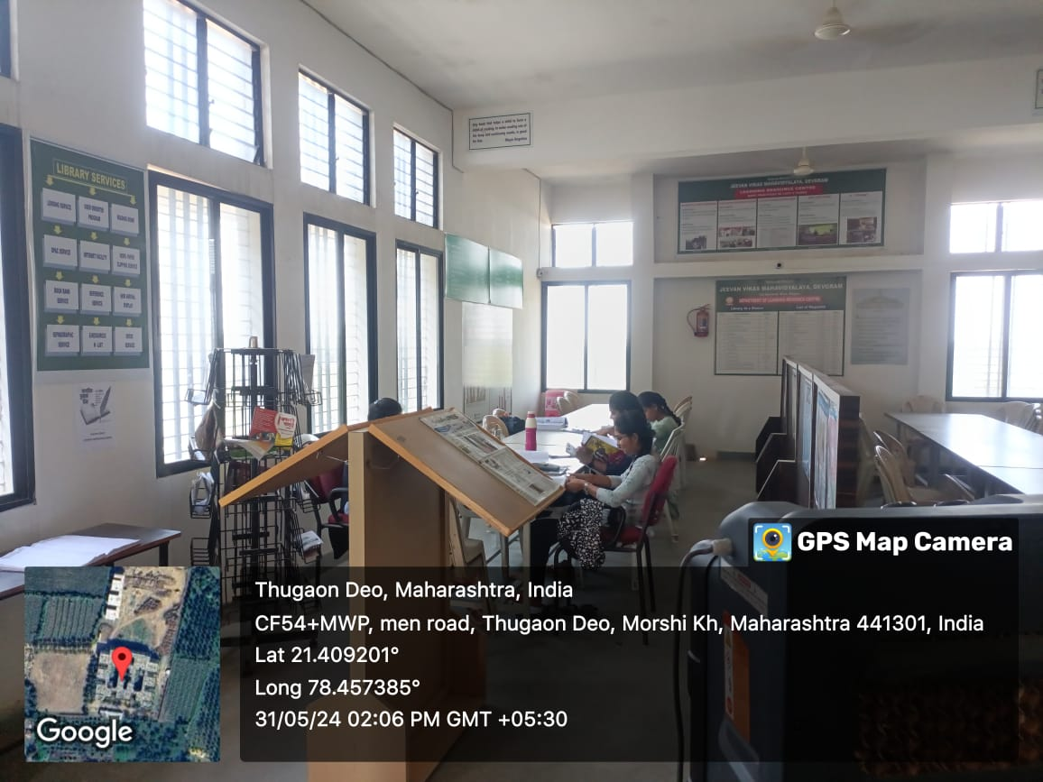

Slide 4
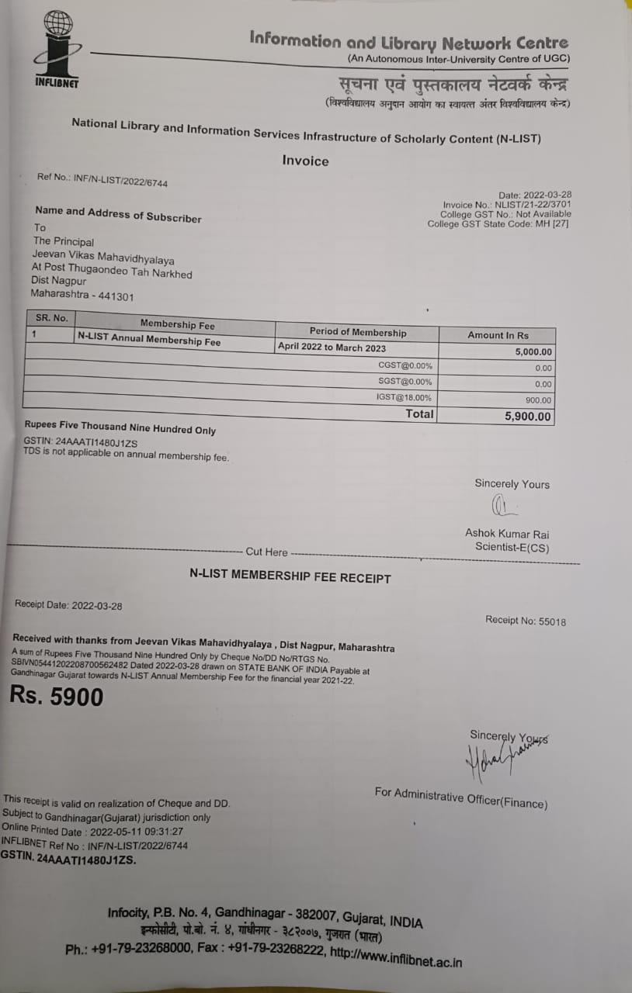

Slide 5
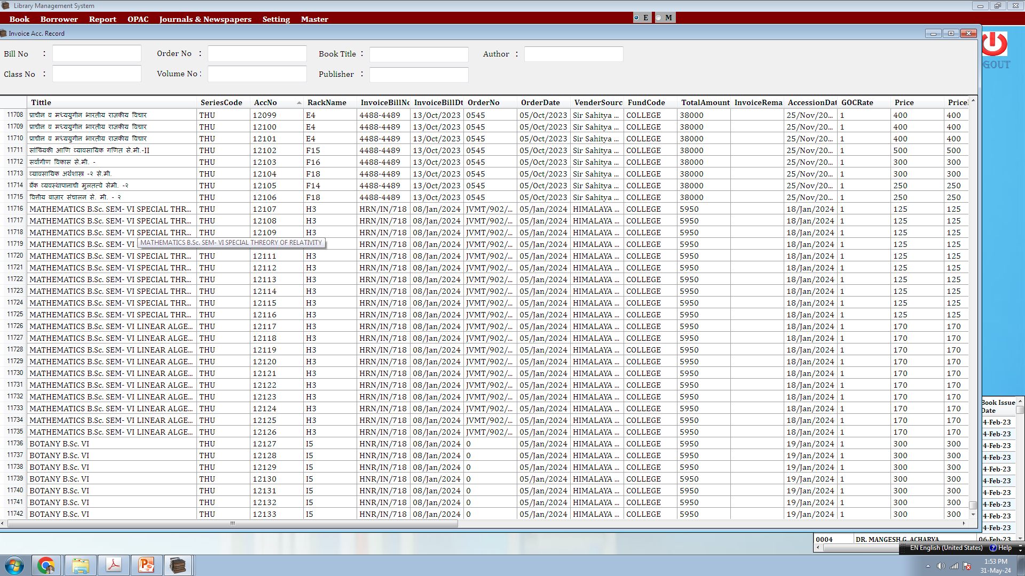

Slide 6
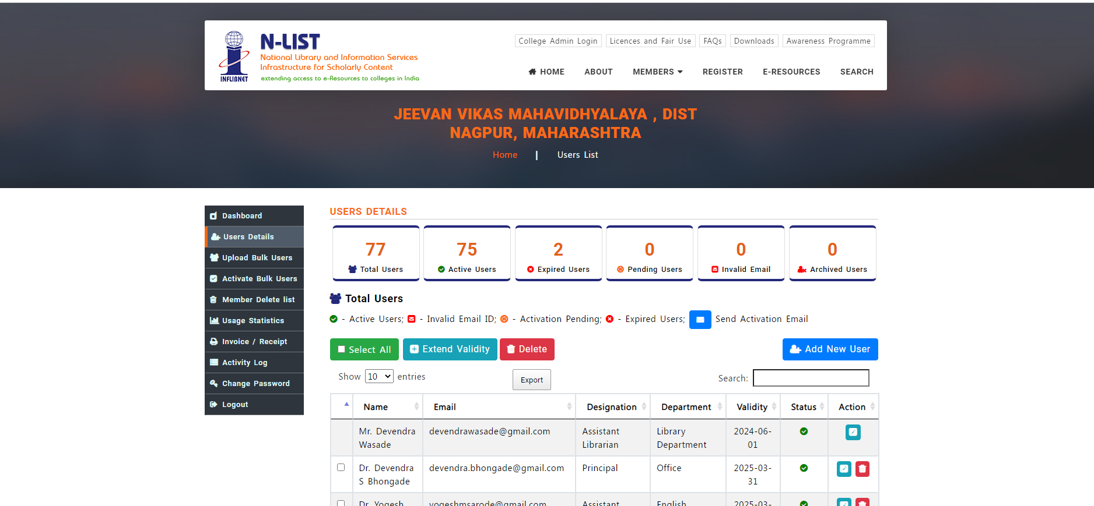

Slide 7
